Slide 1

Basic Details of the Team and Problem Statement
Ministry/Organization Name/Student Innovation: Government of Gujarat
PS Code: SIH1363
Problem Statement Title: Self-identifying the mental health status and get guidance for support.
Team Name: UNO
Team Leader Name: Dhruv Dangi
Institute Code (AISHE): U - 0136
Institute Name: Gujarat University
Theme Name: Fitness and

Slide 2
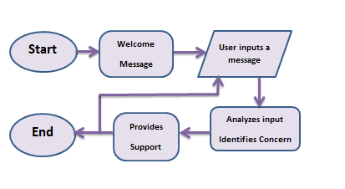
Idea/Approach Details
Describe your idea/solution/prototype here:
Idea: Develop a chatbot offering real-time emotional support and coping strategies.
Solution: A chatbot that provides empathetic responses, personalized support, and connects users to mental health resources.
Prototype: Functional prototype showcasing chat interactions and mood tracking. In this version, I've included the "Idea" component, which highlights your initial concept or vision for addressing the identified problem.
Technology stack:
Language: Python
Library: random, tkinker, difflib

Slide 3
Idea/Approach Details
Describe your Use Cases here
Describe your Dependencies / Show stopper here
Emotional Support and Coping
Therapy and Counseling
Stress Reduction and Relaxation
Crisis Intervention
Post-Traumatic Stress Disorder (PTSD) Support
Well-Being Assessment
Peer Support and Community Building
Symptom Monitoring
There are several dependencies and potential show stoppers that need to be carefully considered during its design and implementation. Failure to address these dependencies can lead to issues with the chatbot's functionality, ethical concerns, and user safety. Here are some crucial dependencies and potential show stoppers:
Data Privacy and Security
Accuracy and Reliability
User Empowerment
Monitoring and Evaluation

Slide 4
Team Member Details
Team Leader Name: Dhruv Dangi
Branch : B.Sc Stream (Data Science): Year (Il):
Team Member 1 Name: Hima Marvania
Branch : B.Sc Stream (Data Science): Year (II):
Team Member 2 Name: Prachi Patel
Branch : B.Sc Stream (Data Science): Year (II):
Team Member 3 Name: Vaidehi Chaudhary
Branch : B.Sc Stream (Data Science): Year (II):
Team Member 4 Name: Anjali Bokka
Branch : B.Sc Stream (Data Science): Year (II):
Team Member 5 Name: Krish Valu
Branch : B.Sc Stream (AIML): Year (I):

